Slide 1
CS5100: Foundations of Artificial Intelligence Constraint Satisfaction Problems (CSP)
Dr. Rutu Mulkar-Mehta
Lecture 2
Some slides and images used from Berkeley CS188 course notes, with permission

Slide 2
Administrative
Assignment P0 – How many did it?
Project 1 - How many started it?
If you have not started it, please start now
Submission details to follow next week
Last week’s in-class assignment – Will be graded and handed back to you next week
If you are not happy with your performance, don’t worry, I will drop your lowest scoring assignment
You will have several opportunities to earn extra credit
If you have questions about how your assignment was graded, contact me
Today – We have a take home assignment for “Extra credit”. Please submit your assignment using Gradescope

Slide 3
Search: Review
Uninformed Search
DFS, BFS, UCS, Iterative Deepening etc.
Informed Search
Best First Search
Greedy Best First Search
A* Search

Slide 4
Limitations of Simple Search
State is considered a “black box”
a data structure that supports
successor function – f(n)
heuristic function – h(n)
goal test
What if we had some constraints on states of our problem?

Slide 5
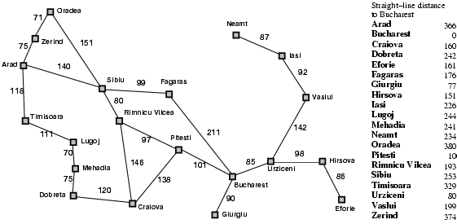
Constraint Examples
Eg. constraints:
Sibiu only allows traffic from Oradea
Pitesti has a lot of construction going on, avoid it
Fagaras charges tolls, avoid it

Slide 6
Outline for Today
Constraint Satisfaction Problems (CSP)
Solving CSP’s using Backtracking search

Slide 7
Constraint satisfaction problems (CSPs)
Factored Representation of each state.
Each state has variables that can take a value
Use general purpose rather than problem specific heuristics
Components
X_{1..n} : A set of Variables
D_{1..n} : A set of Domains
C : A set of constraints that specify allowable combination of values
<scope, rel>
Notes:
scope – tuple of variables that participate in a constraint
rel – values that those variables can take on

Slide 8
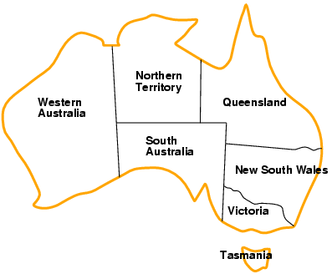
Example: Map-Coloring
Variables WA, NT, Q, NSW, V, SA, T
Domains D_{i} = {red, green, blue}
Constraints: adjacent regions must have different colors
How many constraints do we have?
e.g.,
WA ≠ NT
(WA,NT) in {(red, green), (red, blue),
(green, red), (green, blue),
(blue, red),(blue, green)}
Notes:
The first example is an “Abbreviation”
The second example is an “Enumeration”

Slide 9
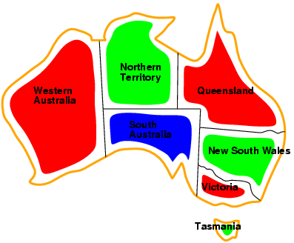
Example: Map-Coloring
e.g., WA = red, NT = green, Q = red,
NSW = green, V = red, SA = blue, T = green

Slide 10
How are CSP’s evaluated?
Complete
One in which every variable is assigned a solution
Consistent
One in which no constraints are violated

Slide 11
Why formulate a problem as a CSP?
CSP’s are a natural representation of a wide variety of problems
CSP’s are generic – if you have an implementation of one CSP, you can use it to solve different problems
CSP’s are faster problem solvers, as they quickly eliminate a large number of state spaces

Slide 12
CSP’s are fast Problem Solvers
If SA = Blue, none of the other neighbors can be blue
Search Complexity?
3⁵ Next States = 243
CSP Complexity?
2⁵ Next States = 32
CSP has a reduction of 87%
Notes:
Starting with the variable that has the most number of constraints helps in reducing the search space

Slide 13
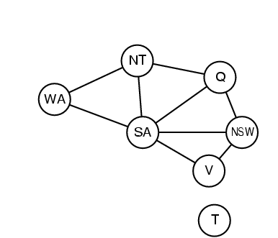
Constraint graph
Constraint graph: nodes are variables, arcs are constraints
Binary CSP: each constraint relates two variables

Slide 14
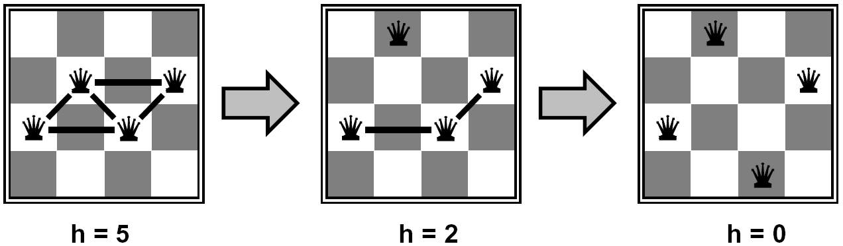







Example: N-Queens
Variables:
(k is the row)
Domains:
(These are the columns)
Constraints:
Q_{i} != Q_{j} (cannot be in the same row)
|Q_{i} – Q_{j}| != |i-j| (cannot be in the same diagonal)
Q1 = 2
Q2 = 4
Q3 = 1
Q4 = 3
Implicit:
Explicit:
Notes:
Constraints – Qi and Qj cannot be in : Same row, same column or same diagonal

Slide 15
Scheduling Constraints: Job-Shop
Scheduling a car assembly: (15 Tasks)
Install Axles (front and back)
Install Wheels (4 wheels)
Tighten nuts for each wheel
Affix Hubcaps
Inspect Final assembly
Constraints: Task Dependencies
e.g. Axels must be installed before wheel
e.g. All assemble must be done before final inspection
e.g. Axle_{F} + 10 <= Wheel_{RF}
(Front Axel + 10 minutes <= Rear Front wheel)

Slide 16
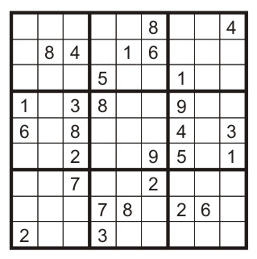
Example: Sudoku
How many Variables, Domains and Constraints?
Variables:
Each (open) square
Domains:
{1,2,…,9}
Constraints:
9-way alldiff for each column
9-way alldiff for each row
9-way alldiff for each region
(or can have a bunch of pairwise inequality constraints)
Notes:
Why do we prefer alldiff over a bunch of pairwise inequality constraints
Q – How many variables? 81
Q – How many Domains? 9
Q – How many “alldiff” constraints? 27

Slide 17
Variations of CSP Formalisms
Variables: Discrete vs Continuous
Map coloring?
N-Queens?
Scheduling?
Domains: Finite vs Infinite
Map coloring?
N-Queens?
Scheduling?
Notes:
Variables – all 3 are discrete variables
Domains – Map coloring: finite, N-Queens: Finite, Scheduling: Could be infinite if no deadline is scheduled

Slide 18
Variations of CSP Formalisms
Discrete variables and Finite Domains
n: variables, d: domain
How many assignments?
O(d^{n}) complete assignments
Discrete Variables and Infinite domains:
integers, strings, etc.
e.g., job scheduling, variables are start/end days for each job
need a constraint language, e.g., StartJob₁ + 5 ≤ StartJob₃
Continuous variables
e.g., start/end times for Hubble Space Telescope observations
linear constraints solvable in polynomial time by linear programming
Notes:
d – domain is like the branching factor
n – is like the depth
Map coloring – 3 colors and 5 regions – 3^5

Slide 19
Varieties of constraints
Unary constraints involve a single variable,
e.g., SA ≠ green
Binary constraints involve pairs of variables,
e.g., SA ≠ WA
Higher-order (Global Constraint) constraints involve 3 or more variables,
e.g., alldiff in Sudoku,
e.g. cryptarithmetic column constraints

Slide 20
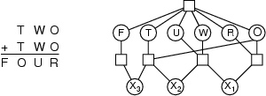
Example: Cryptarithmetic
Variables: F T U W R O X₁ X₂ X₃
Domains: {0, 1, 2, 3, 4, 5, 6, 7, 8, 9}
Constraints: Alldiff (F,T,U,W,R,O)
O + O = R + 10 · X₁
X₁ + W + W = U + 10 · X₂
X₂ + T + T = O + 10 · X₃
X₃ = F, T ≠ 0, F ≠ 0

Slide 21
Constraint Hypergraph
Nodes – Circles
Hyper nodes – Square (represent n-ary constraints)
Notes:
Beginnings of a Neural Network – We will talk more about this in the Statistics and Machine Learning portion of this class

Slide 22
Dual Graph Transformation
The process of transforming an n-ary relation into a binary relation
This is however not preferred – why?
Less error prone and easier to implement global constraints like alldiff
Special complex algorithms for higher order constraints that might not be available for lower order constraints

Slide 23
Preference Constraints
They are not required constraints, but preferred constraints
e.g. avoiding toll roads is not required, but preferred
Encoded as costs on individual variable assignments. Higher costs make a more expensive path and is not preferred
We want our Objective Function to reduce the overall costs
This is the Constraint Optimization Problem

Slide 24
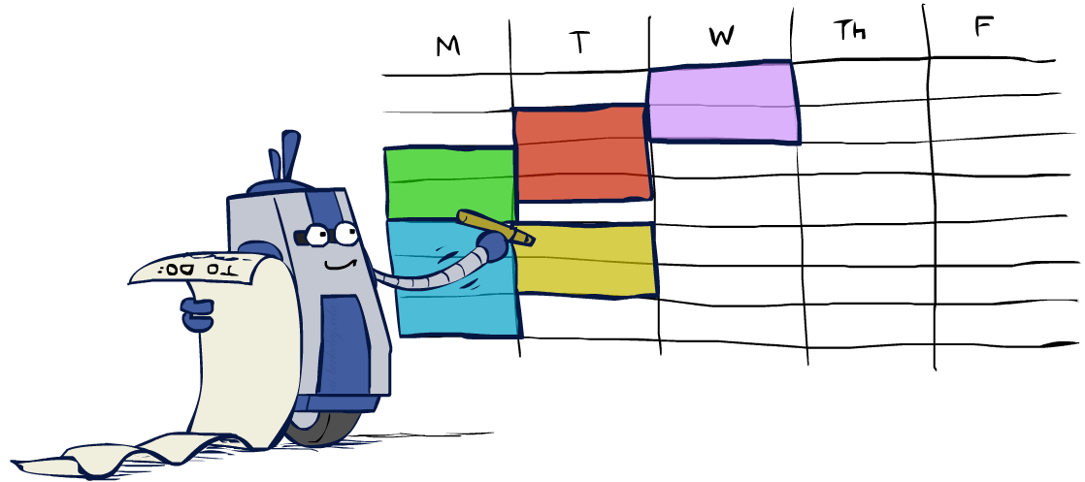
Real-World CSPs
Assignment problems: e.g., who teaches what class
Timetabling problems: e.g., which class is offered when and where?
Hardware configuration
Transportation scheduling
Factory scheduling
Circuit layout
Fault diagnosis
… lots more!
Many real-world problems involve real-valued variables…

Slide 25

Solving CSPs

Slide 26

Standard Search Formulation
States defined by the values assigned so far (partial assignments)
Initial state:
the empty assignment, {}
Successor function: assign a value to an unassigned variable
Goal test: the current assignment is complete and satisfies all constraints
We’ll start with the straightforward, naïve approach, then improve it

Slide 27
Search Methods
What would BFS do?
What would DFS do?
What problems does naïve search have?

Slide 28
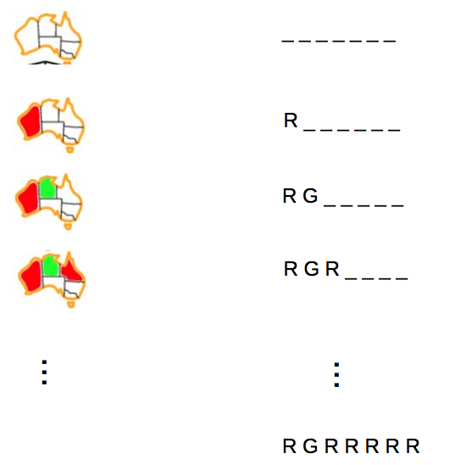
Naïve Solution: Apply BFS, DFS, A*…
How many leaf nodes are expanded in the words case?
How many Variables?
How many Domains?
Notes:
Total Leaf Nodes: 3 ^ 7
3 domains and 7 variables

Slide 29

Backtracking Search

Slide 30
Backtracking Search
The term Backtracking Search is used for a depth-first search that chooses values for one variable at a time and backtracks when a variable has no legal values left to assign

Slide 31
Backtracking Search
Backtracking search is the basic uninformed algorithm for solving CSPs
Idea 1: One variable at a time
Variable assignments are commutative, so fix ordering
I.e., [WA = red then NT = green] same as [NT = green then WA = red]
Only need to consider assignments to a single variable at each step
Idea 2: Check constraints as you go
I.e. consider only values which do not conflict previous assignments
Might have to do some computation to check the constraints
“Incremental goal test”
Depth-first search with these two improvements
is called backtracking search
Can solve n-queens for n ≈ 25

Slide 32
Backtracking Example

Slide 33
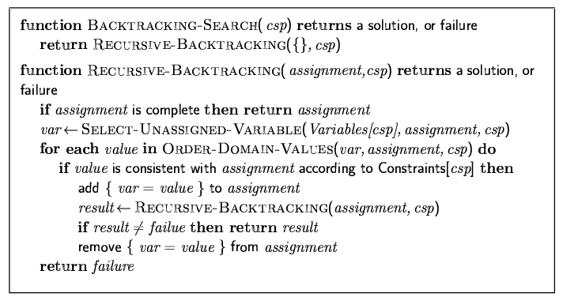
Backtracking Search
Backtracking = DFS + variable-ordering + fail-on-violation

Slide 34

Video of Demo Coloring – Backtracking

Slide 35

Improving Backtracking
Which variable should be assigned next?
In what order should its values be tried?
Can we detect inevitable failure early and filter out bad states?
Notes:
Structure: Can we exploit the problem structure?

Slide 36
Ordering: Minimum Remaining Values
Variable Ordering: Minimum remaining values (MRV):
Choose the variable with the fewest legal left values in its domain
Why min rather than max?
Also called “most constrained variable”
“Fail-fast” ordering

Slide 37

Ordering: Degree Heuristic
Tie-breaker among MRV variables
Degree Heuristic:
choose the variable with the most constraints on remaining variables

Slide 38
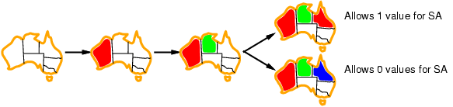
Ordering: Least Constraining Value
Given a variable, choose the least constraining value:
the one that rules out the fewest values in the remaining variables
Combining these heuristics makes 1000 queens feasible

Slide 39
Filtering: Forward Checking
Keep track of domains for unassigned variables and cross off bad options
Forward checking: Cross off values that violate a constraint when added to the existing assignment
NT
Q
WA
SA
NSW
V

Slide 40
Video of Demo Coloring – Backtracking with Forward Checking

Slide 41
Filtering: Constraint Propagation
Forward checking propagates information from assigned to unassigned variables, but doesn't provide early detection for all failures:
NT and SA cannot both be blue!
Why didn’t we detect this yet?
Constraint propagation: reason from constraint to constraint
NT
Q
WA
SA
NSW
V

Slide 42
Constraint Propagation
Node Consistency
A single variable corresponding to a node in the CSP network is node consistent, if all the values in the variable’s domain satisfy the variables unary constraints
Arc Consistency
A variable in CSP is arc consistent if every value in its domain satisfies the variables binary constraints
e.g. Y = X²
e.g. Map Coloring Problem

Slide 43
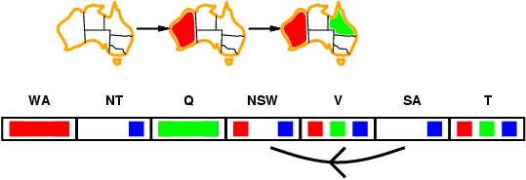
Arc consistency
Simplest form of propagation makes each arc consistent
X →Y is consistent iff
for every value x of X there is some allowed y

Slide 44
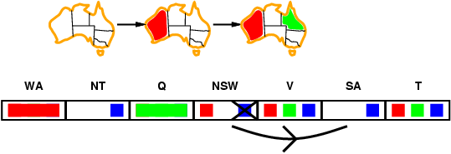
Arc consistency
Simplest form of propagation makes each arc consistent
X →Y is consistent iff
for every value x of X there is some allowed y

Slide 45
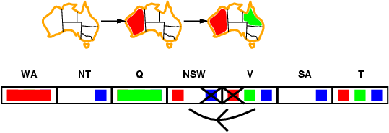
Arc consistency
Simplest form of propagation makes each arc consistent
X →Y is consistent iff
for every value x of X there is some allowed y
If X loses a value, neighbors of X need to be rechecked

Slide 46
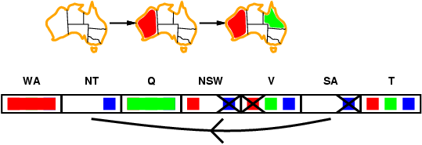
Arc consistency
Simplest form of propagation makes each arc consistent
X →Y is consistent iff
for every value x of X there is some allowed y
If X loses a value, neighbors of X need to be rechecked
Arc consistency detects failure earlier than forward checking
Can be run as a preprocessor or after each assignment

Slide 47
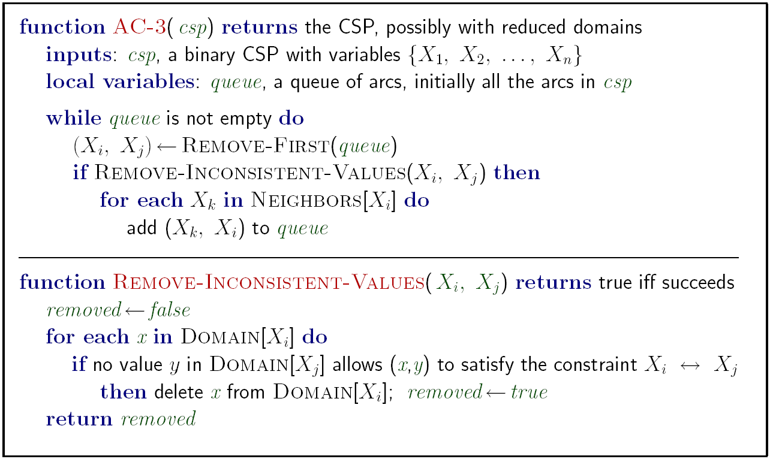
Enforcing Arc Consistency in a CSP
Notes:
Auto-consistency (note initially nothing gets deleted/pruned since there are consistent options for all constraints for initial variable domains)
Flashes whenever something needs to be re-checked

Slide 48
Video of Demo Arc Consistency – CSP Applet – n Queens

Slide 49
Limitations of Arc Consistency
After enforcing arc consistency:
Can have one solution left
Can have multiple solutions left
Can have no solutions left (and not know it)
Arc consistency still runs inside a backtracking search!
What went wrong here?

Slide 50
Constraint Propagation
What if we have 2 colors for Map coloring problem? (blue, red)
Is it arc consistent? – Yes
Does that help? – No
Path Consistency
{X_{i}, X_{j}} are path consistent with X_{m}, if for every assignment {X_{i =} a, X_{j}=b}, there is an assignment that satisfied X_{m}
e.g. blue and red colors for Map problem

Slide 51
Video of Demo Coloring – Backtracking with Forward Checking – Complex Graph

Slide 52
Video of Demo Coloring – Backtracking with Arc Consistency – Complex Graph

Slide 53
Summary
CSPs are a special kind of problem:
states defined by values of a fixed set of variables
goal test defined by constraints on variable values
Backtracking Search = depth-first search with one variable assigned per node
Variable ordering and value selection heuristics help significantly
Forward checking prevents assignments that guarantee later failure
Constraint propagation (e.g., arc consistency) does additional work to constrain values and detect inconsistencies

Slide 54
Submission Instructions
https://gradescope.com/courses/3703
Entry Code: 9NEERM

